Slide 1


Slide 2
Our extensive experience makes us an integrated marketing solutions company offering end to end solutions.
We offer ideas to overcome a marketing challenge and see to the execution without communication loss.
Our endeavour is to create a bankability that a client can have on our ideas, creative and execution capabilities.
We are young, Passionate and Energetic when it comes to our profession. It is also something that we love to do.

Slide 3
SERVICES
CREATIVE & DESIGN
Starting from the Brand identity to Communication Campaign, Product Design to Packaging Design, strategically backed idea is our specialty.
WEB & DIGITAL SERVICES
The brand understanding we possess, lets us use the new media to our and our client's advantage, from Web to App and social media to Digital Campaigns.
FILMS, AV & ANIMATION
A picture can say thousand words, imagine words with thirty pictures in a second. Video & Animation are essentials for web & social media today.

Slide 4
01. Creative & Design
Our creative services do not just entail collateral design but usually offers a solution to a marketing challenge faced by a brand, product or service.
360 Degree Campaign
Execution based Design
Innovative Approach
Brand Solutions

Slide 5
Case Studies

Slide 6
Case Study – Mars Chocolates
Brand – Internal Sales Promo

Slide 7
PASSPORT TO SUCCESS
Marketing Challenge
Our Solution
Mars chocolates wanted to create a tool for monitoring the success and achievement of their sales force in a compact form.
For their activity to boost sales team morale, they were looking for something that kind of becomes a personal record keeper for each sales member.
We created a promo that led to the gratification of International Travel.
Appropriate to International travel being the gratification, we created a PASSPORT to track and record activities of the sales person.
This was a passport sized booklet made to look exactly like passport that carried a tracking sheet for sales achievement in Individual’s territory

Slide 8
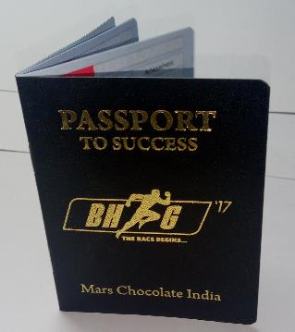
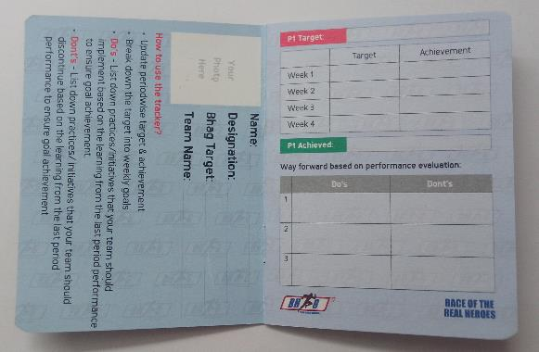
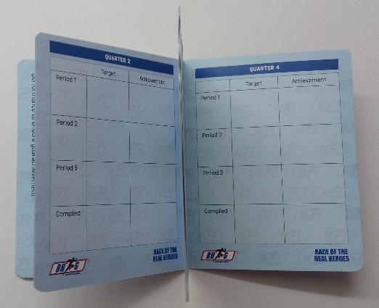
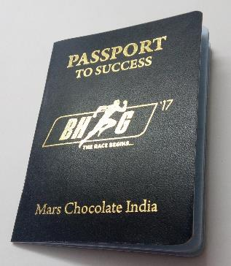

Slide 9
A WORKING EXPERIENCE WITH A MESSAGE
Case Study – SATO (Lixil)
Marketing Challenge
Our Solution
SATO is a Japanese brand that has patented toilet pans for 3rd world countries & South Asian countries.
They were facing a challenge equipping their sales force to demonstrate the functioning of their products to their customers.
SATO wanted to create a demo unit that can be carried, given demo on and has a good look to it.
We created demo unit that not only can be given demo on but it looks pretty sitting at a retail outlet too.
This demo unit was our idea of open defecation free India by getting on a journey of cleanliness.

Slide 10
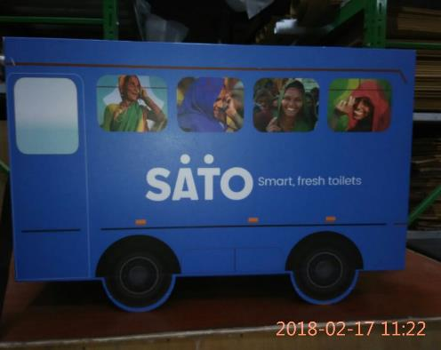
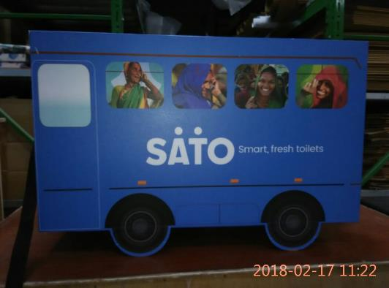
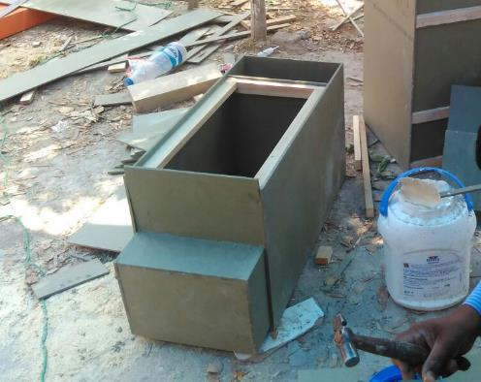
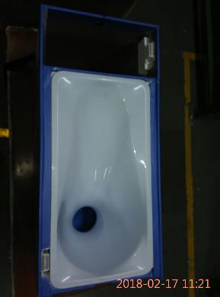
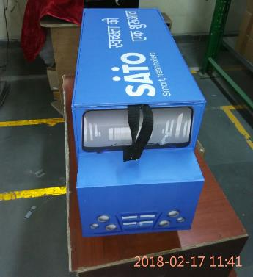
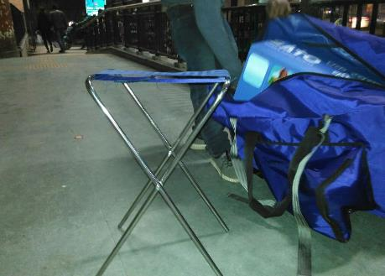
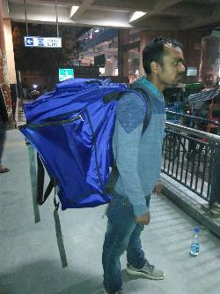
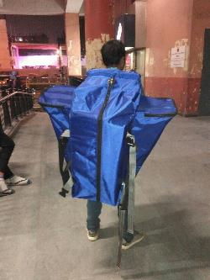

Slide 11
A STORY TO CREATE CHANGE
Case Study – Gajam India (Dharmalife)
Marketing Challenge
Our Solution
Gajam India, a social enterprise is a distribution network for socially relevant products at bottom of the pyramid rural areas in India.
They were facing a challenge equipping their sales force to effectively communicate with their customers. As their objective was to bring about change in consumer behaviour at rural level a rudimentary methods of communication was not viable.
We created a story that was appropriate for creating an impression on the target audience to induce behaviour change.
Complete with illustration and interesting facts, the story was created in form of a Visual Aid in bright colors to attract the TG

Slide 12
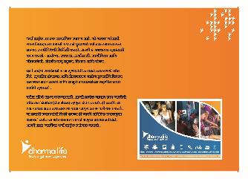
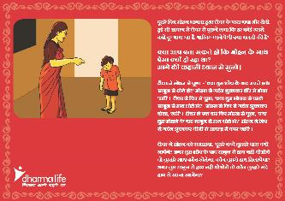
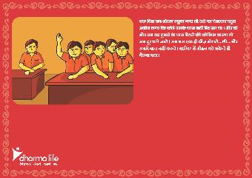
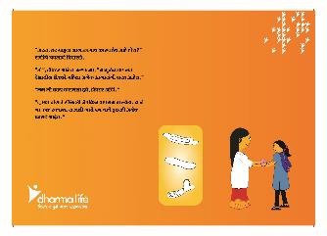

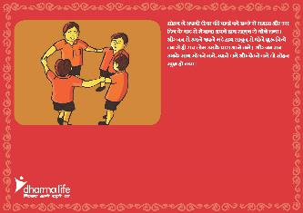

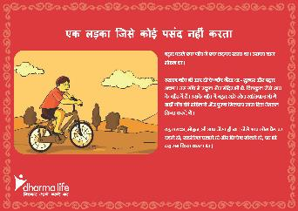
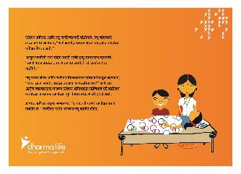


Slide 13
A DIRECT MAILER WITH WOW ELEMENT
Case Study – Mars Chocolates
Marketing Challenge
Our Solution
M & M has been in India through Imports by retailers. Now the company, Mars Chocolates, who owns brand M&M is lunching it in India.
They wanted to establish a direct connection with the modern trade store owners and communicate about the availability of M&M in India through company.
Understanding that this communication needs to be something special and cannot be just a nicely designed mailer, we gave them something that they will never trash.
We created a box in M&M color with the retailers name on a M&M Red character cut out along with chocolate & Peanut butter variants and a Bluetooth speaker.
All this was delivered in a nice box with complete branding.

Slide 14
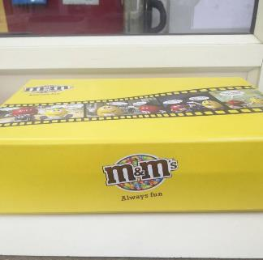
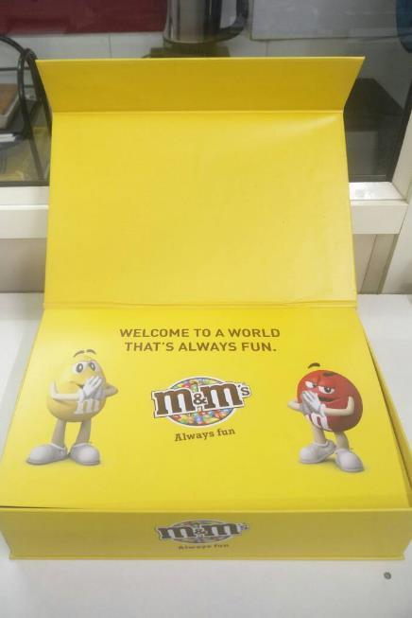
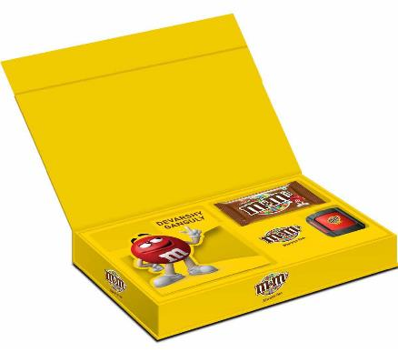
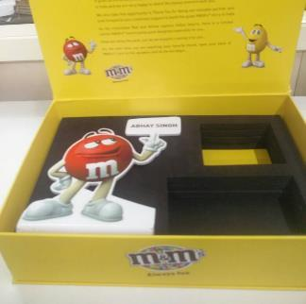

Slide 15
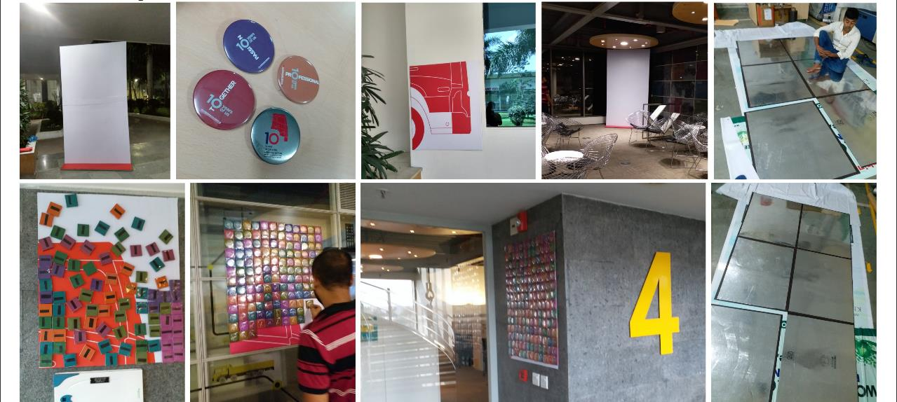
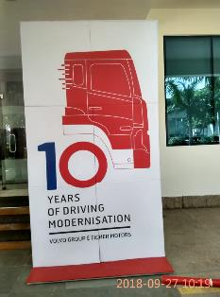
INTERNAL ACTIVATION: 10 year logo was revealed by putting together the six pieces. These pieces were installed at various locations and were hidden using badges. The badges were taken by employees to reveal these pieces and together when they were on the specially created wall, the logo was revealed.

Slide 16
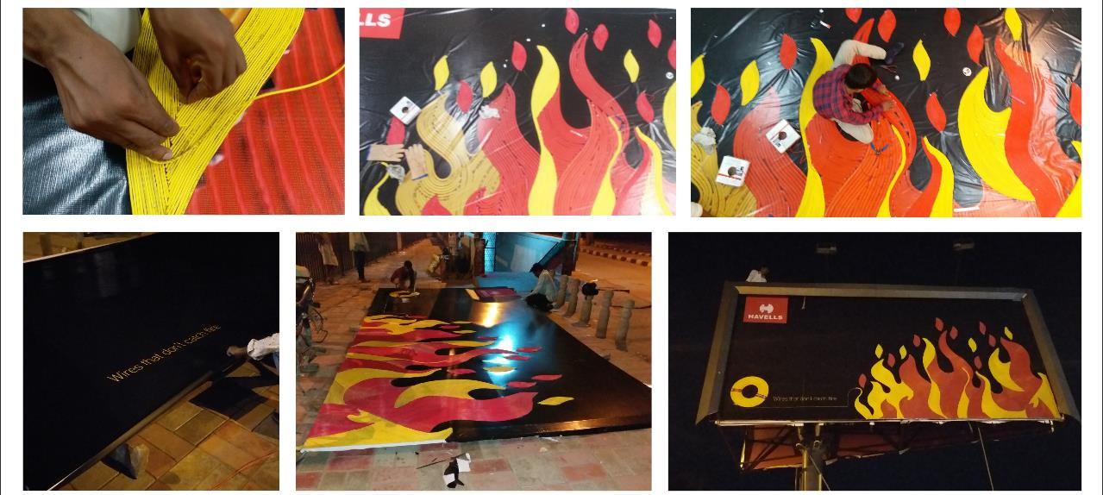
OUTDOOR INNOVATION: The entire hoarding was put together by pasting individual wires in a formation of fire and then were pasted on flex mounted on iron frame. Everything on the flex was made using wires except the Havells logo.

Slide 17
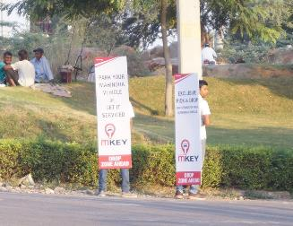
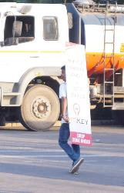
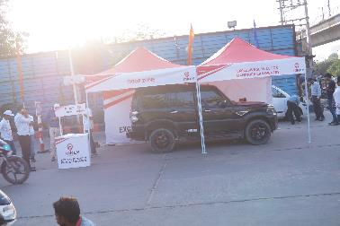
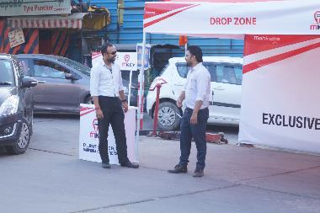
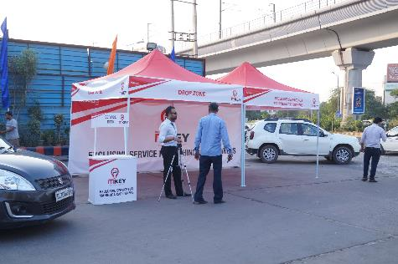
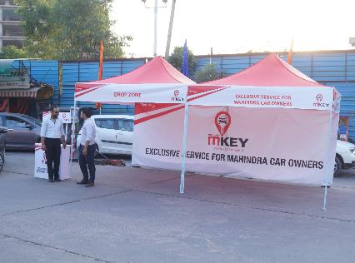
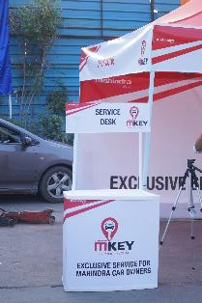
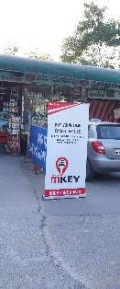
TRUE INTEGRATED PROJECT: mKey from Mahindra, starting from logo design to branding to activation to printing, the complete project was done in-house. Training video was also made in-house.

Slide 18






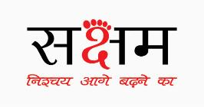













LOGOS

Slide 19


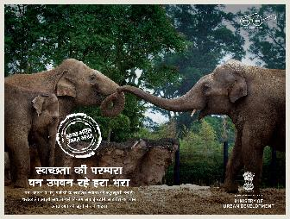

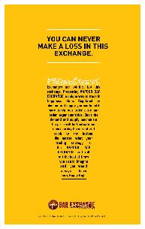





FEW PRINT ADS

Slide 20
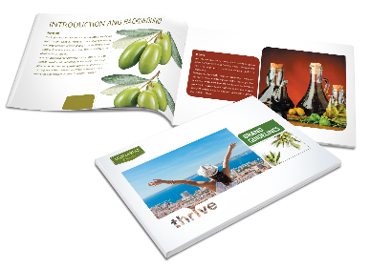
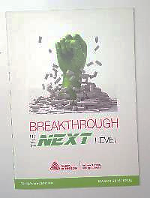
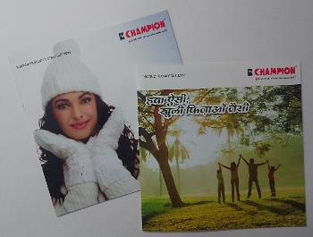

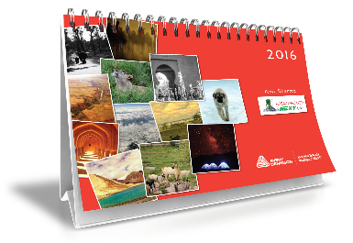

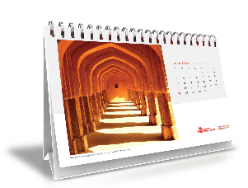
SOME COLLATERALS

Slide 21
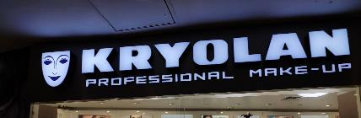
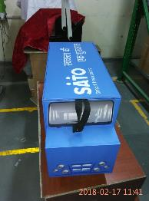
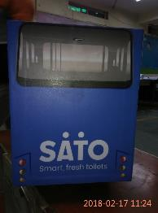
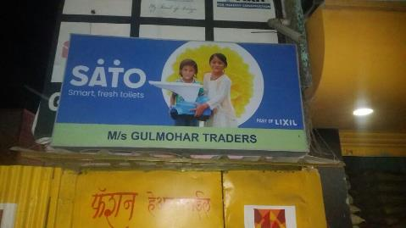
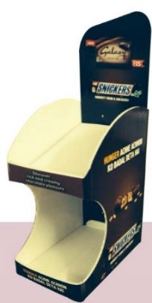
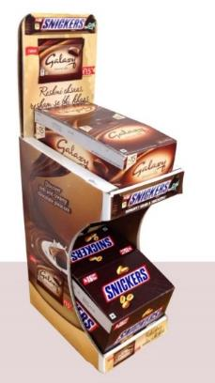

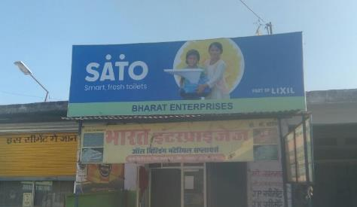
BRANDING DISPLAY – TABLE TOP/FSU, GSB, DEMO UNITS

Slide 22
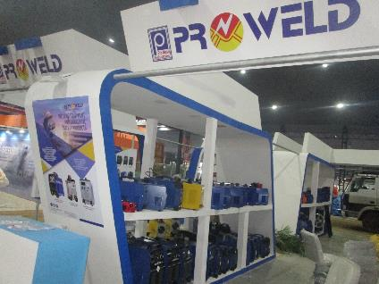





PROWELD INDUSTRIES – MECHAUTO FEB 2019, LUDHIANA

Slide 23







SPARK ENGINEERING – JUNE 2019, RIDEASIA2019, DELHI

Slide 24





LUCKY EXPORTS – JUNE 2019, RIDEASIA2019, DELHI

Slide 25









OTHER EXHIBITIONS- STALL FABRICATION

Slide 26







STORE BRANDING – JULY 2019

Slide 27





GROFERS MARKET ACTIVITY – MEERUT & BHIWADI APR2019

Slide 28









OTHER BRANDING – WALLPAPERS / WALL /GLASS BRANDING

Slide 29









Packaging Desing

Slide 30
02. Web & Digital Services
We offer a wholesome experience that creates a medium of communication that works for your business.
Web & Mobile Apps
Website Design & Development
Digital Marketing
Social Media Management

Slide 31










WEBSITE DEVELOPMENT
www.passiondutapis.com
www.sollunaresort.com
www.motokart.store
Resonant-sys.com
www.karmasthal.com
www.jindalelectric.in

Slide 32





www.urbanretail.in
www.thinkingships.com

Slide 33
















SOCIAL MEDIA CAMPAIGN
Vapour Bar Exchange
Social Media Campaign
International Automotive
Centre of Excellence
Social Media
Jindal Rectifier
Social Media

Slide 34
A Loyalty & Ordering App
Taco Bell Mobile App – iOS & Android

Slide 35
Cheapticket.in – iOS & Android
Online Ticketing App

Slide 36
03. Films, AV & Animation
Shooting a video or creating animation is simple but we offer a solution that resonates with your brand, fulfils your requirements & is cost effective.
Video & Still Shoot
SFX & VFX
Dynamic Digital Content
Animation
Audio Visuals

Slide 37




FILMS
HAMDARD FILMS
MARS SALES DIRECTOR ADDRESS
OMAXE FILM
MARS - DCOM VISIT

Slide 38




AV
IMS GHAZIABAD
MARS LEADERSHIP TEAM VIDEO
PINE LABS BOT LAUNCH TEASER
IACE SOCIAL MEDIA VIDEO

Slide 39




ANIMATION
GALAXY LAUNCH – Sales Video
MARS WRIGLEY TRAINING VIDEO - GURUJI
MARS – GURUJI SEASON 2
ORBIT LAUNCH VIDEO

Slide 40









SOCIAL MEDIA

Slide 41
Our Assets
People, who we work with & work for

Slide 42




















Our Clients

Slide 43


Core Team
Prashant Mishra
Brand Strategy & Creative
Harsh Gangwar
Mobile & Web Development
Over 20 years of experience in Marketing & Brand Management. Passionate about numbers & creative.
A Biking Hobbyist
A thoroughbred Coder, expert in mobile applications specifically iOS. Passionate about Software Solutions.
A travel Enthusiast
Design & Development Team
Rajendra Deolikar
Creative Director – Over 30 years of experience in Advertising & Design
Vivek Pal
Digital Designer – Over 10 years of experience in UI, UX, Web design & Digital Marketing
Vipen Dagar
Editor – Films & Animation Editor with over 5 years of work experience.
Prabhash Rawat
Over 10 years of experience in Web & App development

Slide 44




Corp Off : UG-17, HRC Complex, Vaibhav Khand, Indirapuram, Ghaziabad (Uttar Pradesh) - 201014
Mob: +91 120 311 9213, +91 9999 797 838 Email: connect@brandutsav.com Web: www.brandutsav.com
@brandutsav
@brandutsav
@brand.utsav

